Slide 1

  lesson 6
    Devices that Output Hard Copy

Slide 2
This lesson includes the following sections:
    Overview of Printers
    Dot Matrix Printers
    Ink Jet Printers
    Laser Printers
    Snapshot Printers
    Other High-Quality Printers

Slide 3
Overview of Printers
Categorizing Printers
Evaluating Printers

Slide 4
Overview of Printers - Categorizing Printers
Printers fall into two categories:
Impact printers use a device to strike an inked ribbon, pressing ink from the ribbon onto the paper.
Non-impact printers use different methods to place ink (or another substance) on the page.

Slide 5
Overview of Printers - Evaluating Printers
When evaluating printers, consider four criteria:
Image quality – Measured in dots per inch (dpi). Most printers produce 300 – 600 dpi.
Speed – Measured in pages per minute (ppm) or characters per second (cps).
Initial cost – Consumer printers cost $250 or less, but professional printers can cost thousands of dollars.
Cost of operation – This refers to the cost of supplies used by the printer.

Slide 6
Dot Matrix Printers
How Do Dot Matrix Printers Work?
Performance

Slide 7
Dot Matrix Printers -
How Do Dot Matrix Printers Work?
Dot matrix printers are a common type of impact printer.
A dot matrix printer's print head contains a cluster of pins. The printer can push the pins out to form patterns in rapid sequence.
The pins press an inked ribbon against the paper, creating an image.

Slide 8
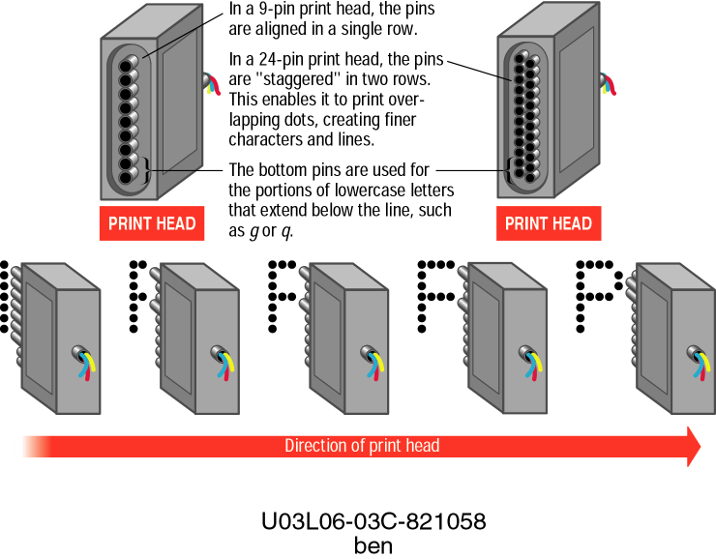

Slide 9
Dot Matrix Printers - Performance
Lower-resolution dot matrix printers use nine pins. Higher-resolution models have 24 pins.
Speed is measured in characters per second (cps). Some dot matrix printers print 500 cps.

Slide 10
Ink Jet Printers
How Do Ink Jet Printers Work?
Performance

Slide 11
Ink Jet Printers –
How Do Ink Jet Printers Work?
Ink jet printers are an example of non-impact printers.
The printer sprays tiny droplets of ink onto the paper.
Ink jet printers are available for color and black-and-white printing.

Slide 12
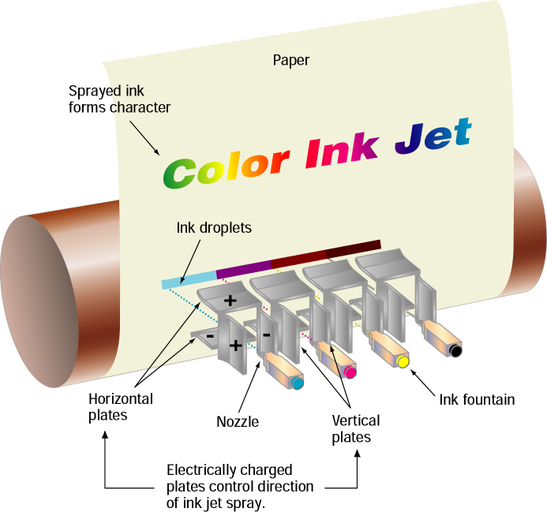

Slide 13
Ink Jet Printers - Performance
Ink jet printers offer speeds of (2 – 4 pages per minute ppm) and resolution (300 – 600 dots per inch dpi), comparable to low-end laser printers.
Ink jet printers are inexpensive and have low operating costs.

Slide 14
Laser Printers
How Do Laser Printers Work?
Performance

Slide 15
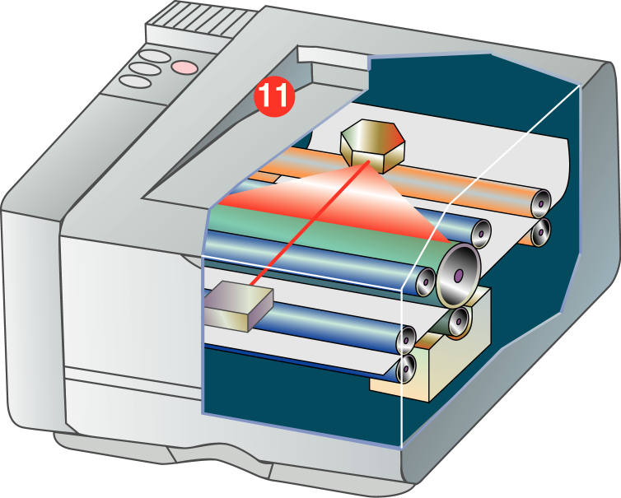
Laser

Slide 16
Laser Printers –
How Do Laser Printers Work?
Laser printers are non-impact printers.
They use heat and pressure to bond particles of toner to paper.
Laser printers are available for color and black-and-white printing.

Slide 17
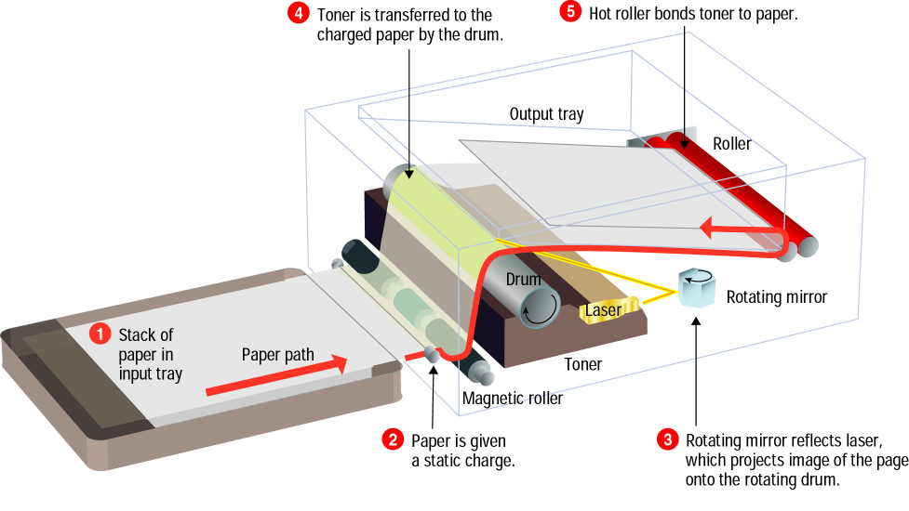

Slide 18
Laser Printers - Performance
Laser printers provide resolutions from 300 – 1200 dpi and higher.
Black-and-white laser printers usually produce 4 – 16 ppm.
Laser printers produce higher-quality print than ink jet printers, but are more expensive.

Slide 19
Snapshot Printers
Snapshot printers are specialized, small-format printers that print digital photographs.
Snapshot printers are fairly slow, and can be more expensive to operate

Slide 20
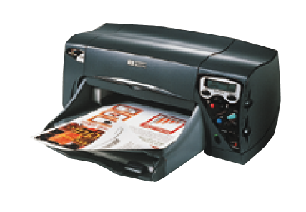
Snapshot printers are popular among
digital camera users

Slide 21
Other High-Quality Printers
Print shops and publishers use these printers to create high-quality color images:
Thermal-wax
Dye-sublimation
Fiery
IRIS
Plotters

Slide 22
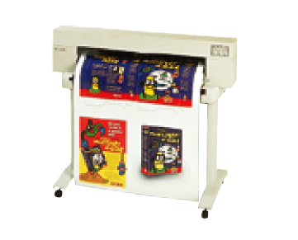
Inkjet Plotter
Plotters use mechanical, ink jet, or thermal technology
to create large-format images for architectural or
engineering uses.

Slide 23
lesson 6 Review
List the three most commonly used types of printers.
List the four criteria you should consider when evaluating printers.
Describe how a dot matrix printer creates an image on a page.
Explain the process by which a laser printer operates.
List five types of high-quality printing devices commonly used in business.

